Slide 1
Predict Revenue
By: Krish Gondaliya

Slide 2
ML Models and MSE
Model Name | MSE
RPART | 17.52254
Random Forest | 20.03397
SVM | 27.39045

Slide 3
So RPART has the best MSE. Therefore, my approach is to fine tune RPART. I learned that RPART does not recognize linear regression well.

Slide 4
Split Based on Source: Revenue vs Duration

Slide 5
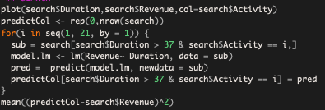
Linear Regression on ”Google Search” based on Activity
After sub-setting the data into only “Google Search”, I split it even further into categories of activity levels. (e.g. 1,2,3,4,….21)
For each activity level, I created a linear regression model based on the relationship between duration and Revenue.
Below Duration of 37, I let RPART predict because it was not linear regression

Slide 6

I couldn’t figure out when it is linear regression and when it is not for the other two sources (Direct Link and Google Ad). Therefore, I left it as RPART prediction

Slide 7



When looking at the subset of DirectLinks…
There were data points that had every attribute the same yet had two different revenues.
Which is why it was VERY difficult to determine the pattern of when it was linear regression and when it was 0 revenue

Slide 8
In conclusion, I used RPART and linear regression to predict the revenue. After cross validation, I received an MSE of around 14.

